Slide 1
Data Privacy Fundamentals

Slide 2
What is Data Privacy?
The aspect of information technology (IT) that deals with the ability an organization or individual has to determine what data in a computer system can be shared with third parties.
The challenge of data privacy is to utilize data while protecting individual's privacy preferences and their personally identifiable information.
The fields of computer security, data security and information security design and utilize software, hardware and human resources to address this issue.

Slide 3
What is Data Privacy?
As the laws and regulations related to Privacy and Data Protection are constantly changing, it is important to keep abreast of any changes in the law and continually reassess compliance with data privacy and security regulations.
Privacy concerns exist wherever personally identifiable information or other sensitive information is collected, stored, used, and finally destroyed or deleted in digital form or otherwise.
Improper or non-existent disclosure control can be the root cause for privacy issues.

Slide 4
What is Data Privacy?
Data privacy issues can arise in response to information from a wide range of sources, such as:
Healthcare records
Criminal justice investigations and proceedings
Financial institutions and transactions
Biological traits, such as genetic material
Residence and geographic records
Ethnicity
Privacy breach
Location-based service and geo-location
Web surfing behavior or user preferences using persistent cookies

Slide 5
Data Security Vs. Data Privacy
Data security is commonly referred to as the confidentiality, availability, and integrity of data.
Data privacy is suitably defined as the appropriate use of data.
When companies and merchants use data or information that is provided or entrusted to them, the data should be used according to the agreed purposes.
Companies need to enact a data security policy for the sole purpose of ensuring data privacy or the privacy of their consumers' information.

Slide 6
Data Security Vs. Data Privacy
Companies must ensure data privacy because the information is an asset to the company.
A data security policy is simply the means to the desired end, which is data privacy.
No data security policy can overcome the willing sell or soliciting of the consumer data that was entrusted to an organization.

Slide 7
Need Of Data Privacy
Every time we use a service, we have to hand over some of our personal information.
Even without our knowledge, information is being generated and captured by companies and agencies we are likely to have never knowingly interacted with.
“The only way citizens and consumers can have confidence in both government and business is through strong data protection practices, with effective legislation to help minimize needless monitoring by officialdom and regulate surveillance by companies.”

Slide 8
Need Of Data Privacy
Data protection rules need to be enforced by a regulator or authority, often called a Privacy Commissioner.
The strength of the powers invested in these authorities varies from country to country and so does its independence from Government.
These powers can include the ability to conduct investigations, act on complaints and impose fines when they discover an organization has broken the law.

Slide 9
Data Protection Laws
As of August 2014, over 100 countries around the world have enacted comprehensive data protection legislation, and several other countries are in the process of passing such laws.
The strongest and most comprehensive laws are in the countries of the European Union and European Economic Area that have implemented the 1995 Data Protection Directive.
Canada is another leading example with two separate pieces of legislation applying at the national level to government and industry.

Slide 10
Data Protection Laws
Data protection law has become not only a vehicle for protecting citizens and consumers, it has became a gateway to trade.
The OECD Guidelines on the Protection of Privacy, first agreed in 1980 and revised in 2013, were the pioneer in establishing the data protection principles, adopted by many countries in their legislation.
The EU's 1995 Directive standardized laws to some extent across European Union member states, partly to enable trade within the European market.

Slide 11
Data Protection Act Principles
The Data Protection Act is the law that protects us against illegal and inappropriate use of our personal information without our consent, and the same applies to us using the information of others
Anyone who processes personal information must comply with eight principles of the Data Protection Act, which make sure that personal information is:
Fairly and lawfully processed
Processed for limited purposes
Adequate, relevant and not excessive
Accurate and up to date
Not kept for longer than is necessary
Processed in line with your rights
Secure
Not transferred to other countries without adequate protection

Slide 12
State of Data Privacy in 2015
According to a recent survey by Dimensional Research, 93% of businesses are challenged by data privacy.
It estimated that by 2018, more than 9 billion U.S. dollars will be lost due to payment card fraud, 6.4 billion due to CNP (card not present) transactions.

Slide 13
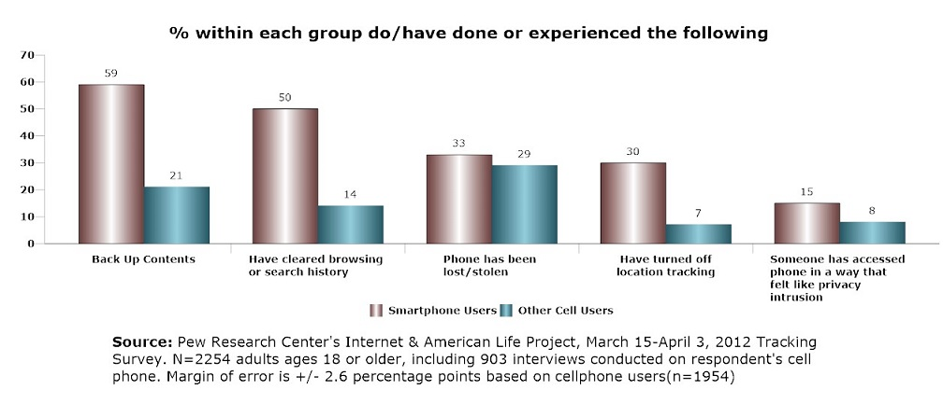
Figure 1. Smartphone vs. Other cell owners on mobile data security [2]

Slide 14
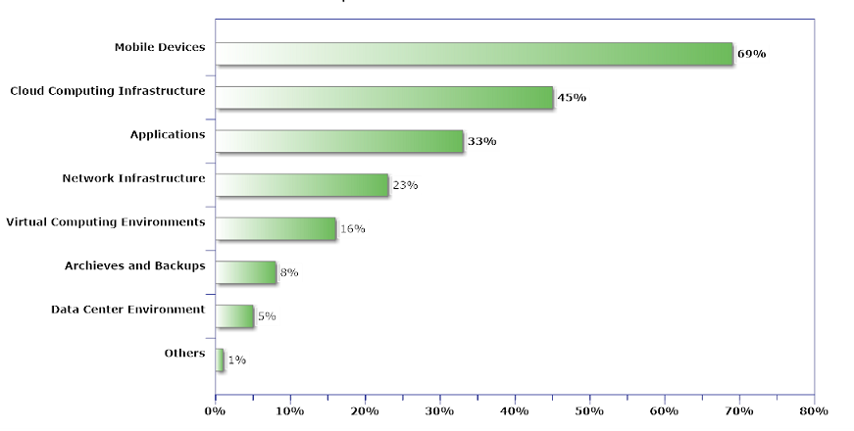
Figure 1I. Percentage data protection risk on regulated data [3]

Slide 15
State of Data Privacy in 2015
Another increasing worry in the online medium is malicious use of personal information intended to humiliate, harass or in other ways damage someone’s reputation.
Especially among youth, internet bullying is one of the biggest fear parents have when it comes to their children’s online safety.

Slide 16
References
[1] | Data Protection Principles in the Personal Data (Privacy) Ordinance – from the Privacy Commissioner’s perspective (2nd Edition), pdf available at: www.pcpd.org.hk. Last accessed August , 2016.
[2] | Pew Research Center, Anonymity, Privacy, and Security Online, available at: http://www.pewinternet.org/2013/09/05/anonymity-privacy-and-security-online/. Last accessed August , 2016.
[3] | Survey, Mobile, cloud computing are source of most healthcare security worries, available at: http://mobihealthnews.com/23519/survey-mobile-cloud-computing-are-source-of-most-healthcare-security-worries/. Last accessed August , 2016.
[4] | Statista, Online Privacy- Statistics and Facts, 2016, available at: http://www.statista.com/topics/2476/online-privacy/. Last accessed August , 2016.

